Slide 1
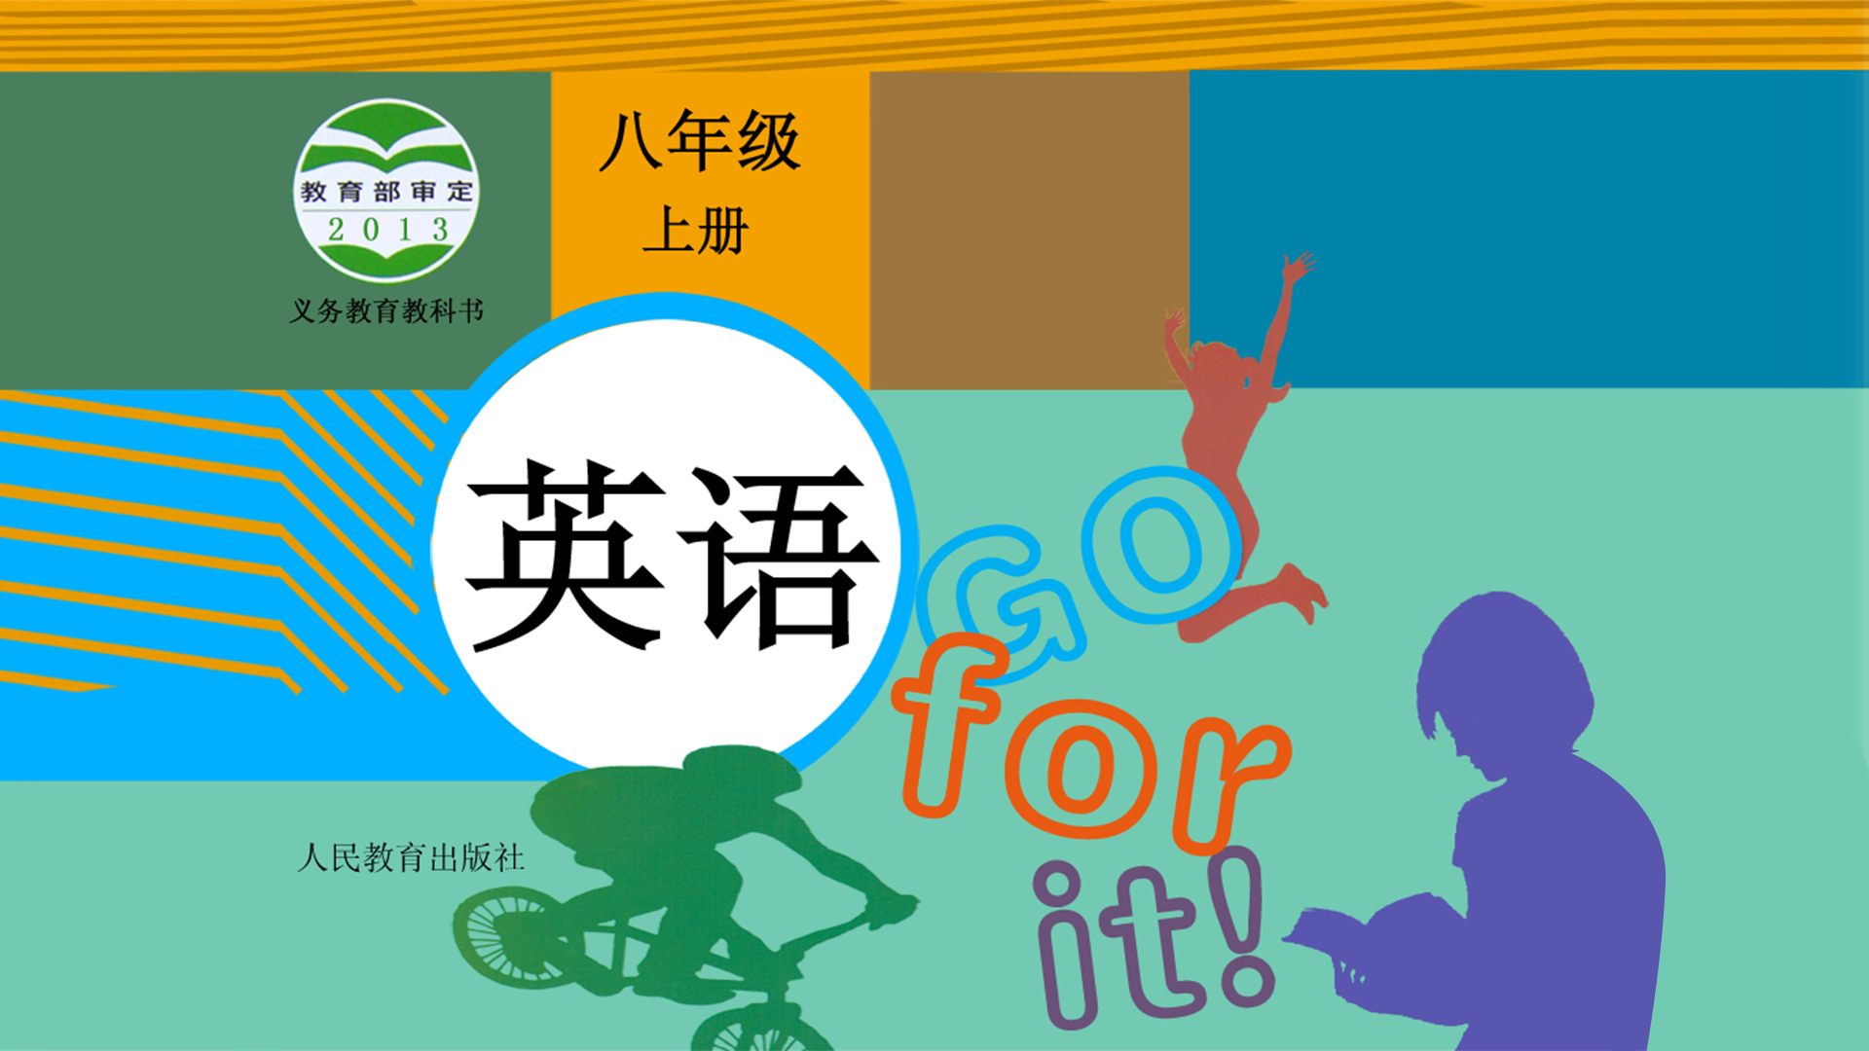
Unit 8

Slide 2
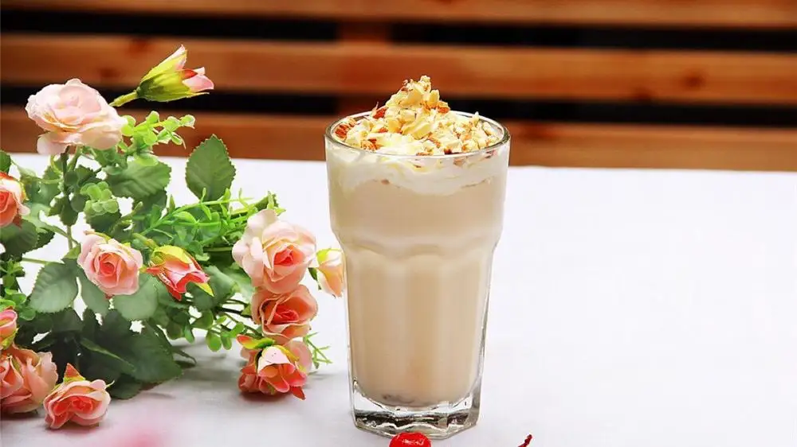
Unit 8
How do you make a banana milk shake?

Slide 3
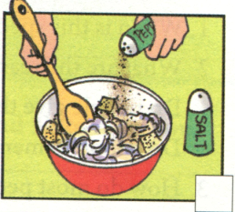
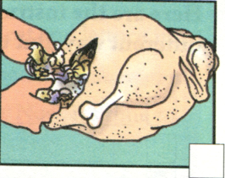
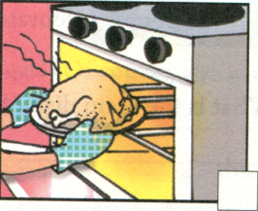
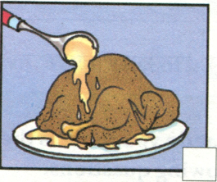
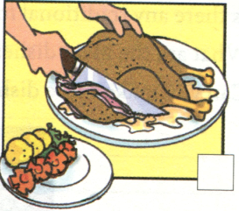
Review: How do we make a turkey dinner?
mix...and/with... fill...with... put...in...and cook...
place...on...and cover...with... cut...into...and eat...

Slide 4
Review
传统食物
在特别的节日
因……表示感谢/感恩
把……和……混在一起
用……装满……
用……覆盖……
将……切成片
用某物招待某人
在高温下
traditional food
on special holidays
give thanks for ...
mix (together)... and/with ...
fill ... with ...
cover ... with ...
cut ... into pieces
serve sth to sb.
at a very high temperature

Slide 5
Dictation
你需要多少酸奶？一杯。
你需要多少个西瓜？两小个。
打开搅拌器。
不要把蜂蜜倒到碗里。
我想要把一勺黄油抹在一片面包上。
在爆米花里加入盐。

Slide 6
Dictation
How much yogurt do you need? A/One cup.
How many watermelons do you need? Two small ones.
Turn on the blender.
Don’t pour the honey into the bowl.
I would like to put a spoon of butter on a piece/slice of bread.
Add the salt in the popcorn.

Slide 7
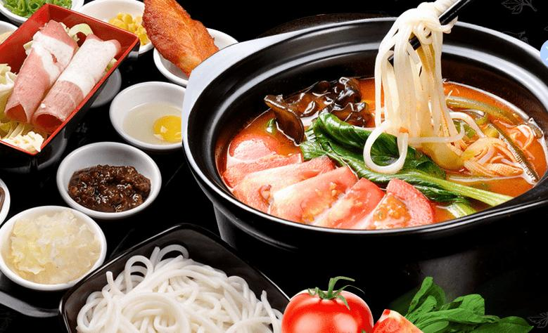


Slide 8





Here are the instructions(用法说明) for making a turkey dinner written in a different way. Put them in order. Write First, Next, Then and Finally.
_______, serve it to your friends with some vegetables.
_______, put this into the bird.
_______, cook it at a very high temperature for a long time.
_______, put everything you need together in a large bowl.
Finally
Next
Then
First

Slide 9

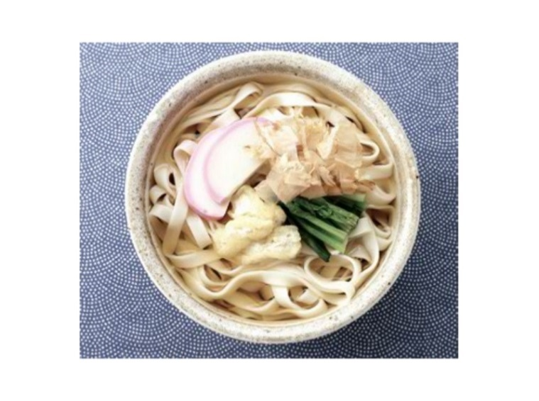
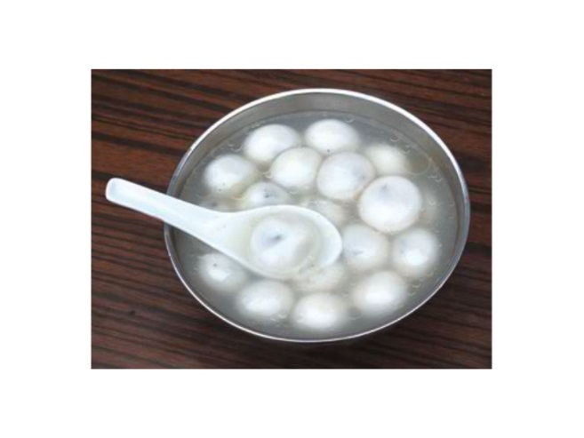
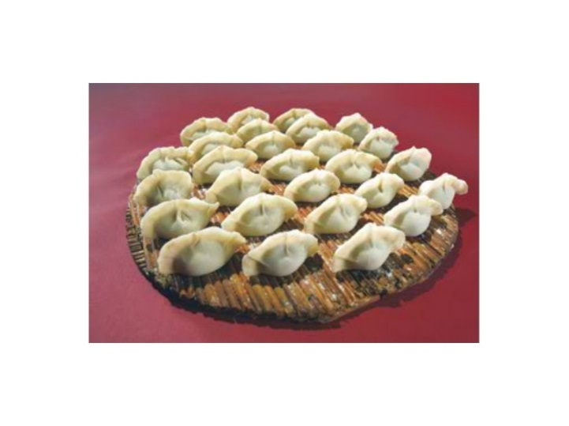
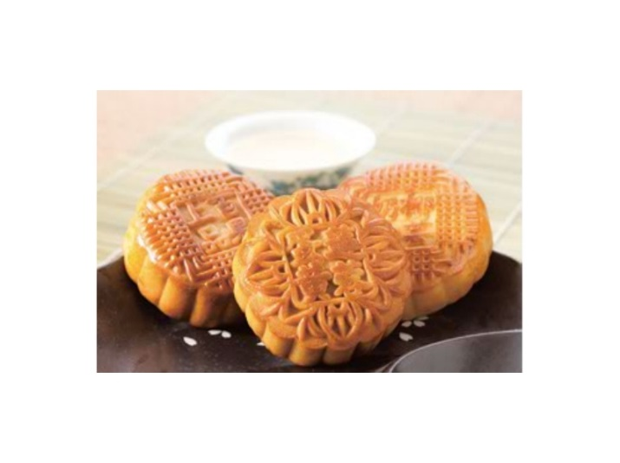
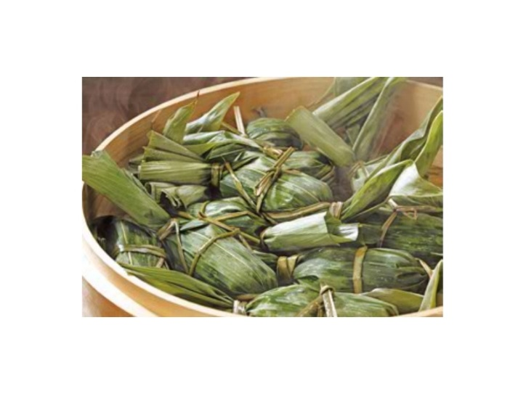
Introduce a traditional food in China.
What (do you think) is the most special day in China? Answer the following questions.
1. When is this special day?
2. What are the reasons for this special day?
Do people give thanks for anything on this day?
Do people remember anything or anyone on this day?
3. How do most people celebrate this day?
4. Is there any traditional food? What are the main dishes?
5. Can you make these dishes?

Slide 10
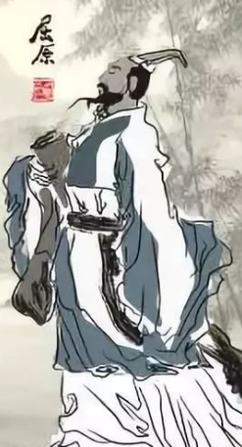
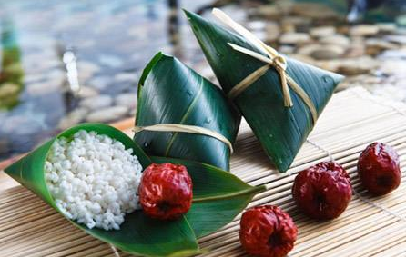
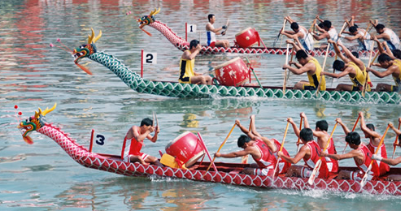
Let’s take Dragon Boat Festival as an example.
When?
Why?
How to celebrate?
What is the main dish?
on the 5th day of the fifth lunar(阴历的) month
remember the famous poet Qu Yuan
eat zongzi; hold dragon boat races;
drink realgar wine(雄黄酒);
hang mugwort (艾叶); wear a spice bag (香囊)
zongzi

Slide 11


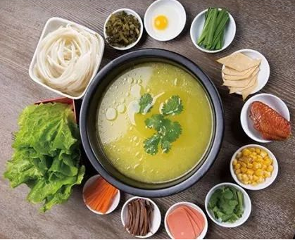
Writing
Write a recipe(食谱) for your favorite food. Use 3a to help you.
Let’s learn a very special food in Yunnan.
Yunnan Rice Noodles

Slide 12

Read the recipe(食谱) and fill in the blanks with the words in the box.
cook next wash finally have enjoy first cut
In Yunnan, many people eat rice noodles for breakfast, and even for lunch and dinner. To(为了) make this special food, you need to _______ rice noodles, chicken soup, chicken, lettuce and eggs. (Of course, you can also have other things like fish and different vegetables.) _______, _______ the lettuce and cut it up. _______, _______ the chicken into pieces. Then, make the chicken soup very hot, over 100℃. Then, _______ the eggs, meat and lettuce in the pot of hot soup, one by one. _______, put the rice noodles into the soup. Now, it’s time to _______ the rice noodles!
have
First
wash
Next
cut
cook
Finally
enjoy

Slide 13
Make a list of ingredients(原料) and tools(工具) of Yunnan Rice Noodles.
Ingredients:
rice noodles
chicken soup
chicken
lettuce
eggs
fish
other vegetables
Tools:
knife
cutting board
pot
big bowl
plate

Slide 14
Write a recipe of Yunnan Rice Noodles.
I’ m good at cooking Yunnan Rice Noodles. Now, let me tell you how to make it. It’s very easy to cook it as long as you follow the steps.
First, prepare rice noodles, chicken soup, chicken, lettuce, eggs, fish and different vegetables.
Wash the lettuce/ different vegetables.
Cut the lettuce/vegetables up.
After that, cut the chicken into pieces.
Next, make the chicken soup very hot, over 100℃.
Then, cook the eggs, meat and lettuce in the pot of hot soup, one by one.
Finally, put the rice noodles into the soup and enjoy them.
I hope you have fun making and eating Yunnan Rice Noodles.

Slide 15


1. Number these instructions for making tomato and egg soup in the correct order. Then complete the instructions with the words in the box.
First Next Then Finally
4
Finally
__________, mix everything together and serve it.
__________, cook for five minutes and add two eggs.
__________, cut up three tomatoes and put them into a pot.
__________, add some water, sugar and salt.
3
Then/Next
1
First
2
Next/Then

Slide 16
2. Write questions and answers using the words in brackets.
How many eggs do we need to make a cake?
Q: ______________________________________
(how many/eggs/we/need/make/cake)
A: ___________________________ (two)
We need two eggs.

Slide 17
How much milk do we need?
2) Q: ______________________________
(how much/milk/we/need)
A: ______________________________
(three cups)
3) Q: ________________________________
(we/have to/add/sugar or honey)
A: ________________________________
(yes/can/add/two spoons/honey)
We need three cups of milk.
Do we have to add sugar or honey?
Yes, we can add two spoons of honey.

Slide 19
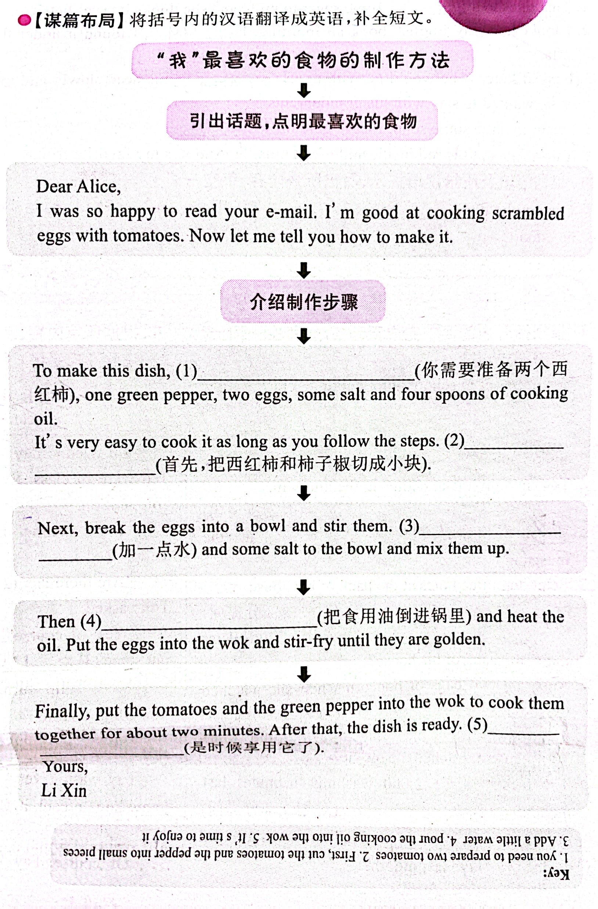

Slide 20



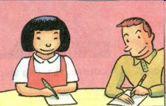
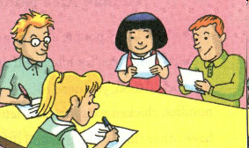
Make up a crazy recipe with your partner. Then tell another pair of students how to make this crazy food. The other pair will draw it.
First, put some yogurt on a piece of bread. Then, cut up one apple and an onion and put them on the yogurt …

Slide 22



To learn the recipe of Yunnan Rice Noodles
To learn to write a recipe for your favorite food

Slide 23


1. What do you think is the most special day in China?
2. What are the reasons for this special day?
3. How do you celebrate it?
4. What are the main dishes?
5. How to make these dishes?

Slide 24

Read the recipe and fill in the blanks with the words in the box.
首先，了解方框中单词的含义, 并阅读短文, 整体把握短文大意。
其次，分析有空格的每个句子, 根据上下文意及固定搭配来确定空格处的意思, 从而确定空格处要填的单词。
最后，再通读一遍短文, 检查是否正确。

Slide 25
cook next wash finally
have enjoy first cut
Yunnan Rice Noodles
In Yunnan, many people eat rice noodles for breakfast, and even for lunch and dinner. To make this special food, you need to _______ rice noodles, chicken soup, chicken, lettuce and eggs. (Of course, you can also have other things like fish and different vegetables.) _______, _______ the lettuce and cut it up. _______, _______ the chicken into pieces.
have
First
wash
Next
cut

Slide 26

cook next wash finally
have enjoy first cut
Then, make the chicken soup very hot, over 100℃. Then, _______ the eggs, meat and lettuce in the pot of hot soup, one by one. _______, put the rice noodles into the soup. Now, it’s time to _______ the rice noodles!
cook
Finally
enjoy

Slide 27


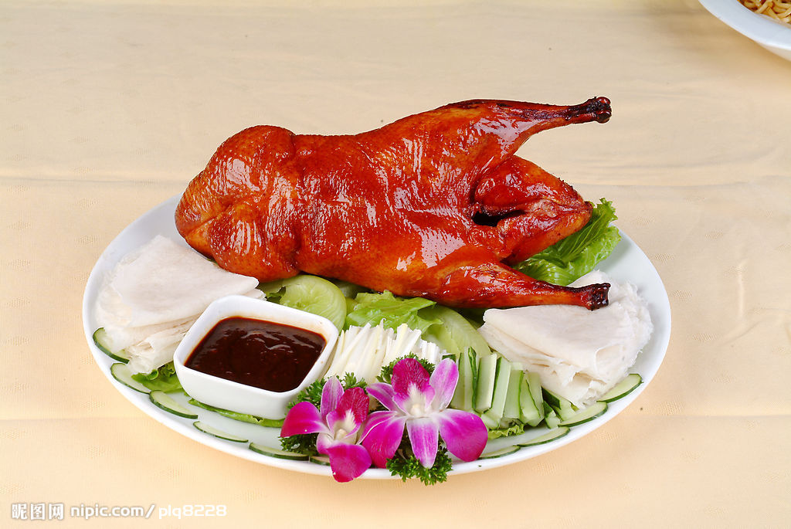
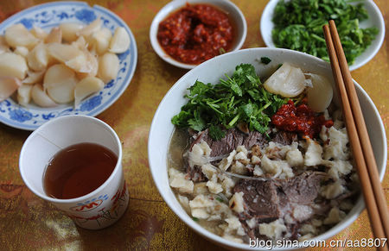
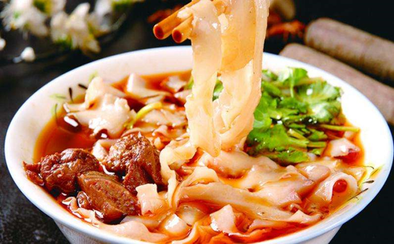
Think of a favorite food in your hometown. Make a list of ingredients.
Beijing Roast Duck
北京烤鸭
Pita Bread Soaked in Lamb Soup
羊肉泡馍
Sliced noodles
山西刀削面

Slide 28

Write a recipe for your favorite food. Use 3a and 3b to help you.
内容：按照先后顺序描述食物的制作方法
文体：说明文 时态：一般现在时 人称：第二人称
句式：介绍食物制作方法时常用祈使句

Slide 29
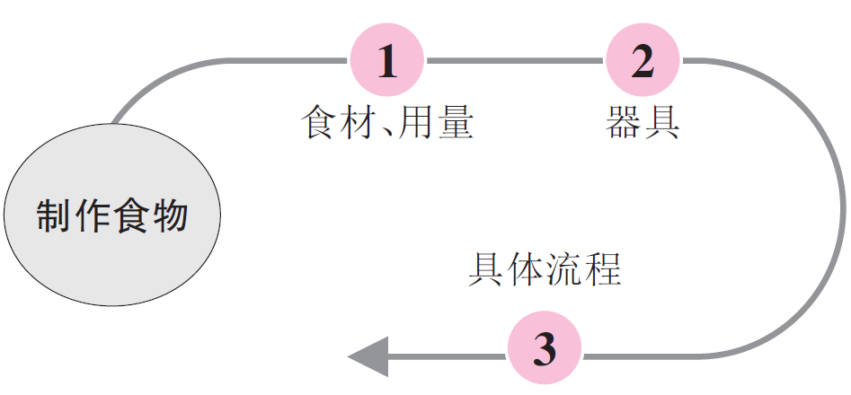
【头脑风暴】

Slide 30
【提供素材】
语块
Ingredients | Fruit: apple, banana, strawberry, watermelon, orange ... Vegetables: onion, potato, carrot, lettuce, cabbage, tomato ... Meat: beef, chicken, mutton ... Others: salt, sugar, pepper, oil, vinegar (醋), ginger (姜), yogurt, honey, butter, milk, flour (面粉), egg, cheese ...

Slide 31
Vessels (器皿) & Tools (工具) | Vessels: pot, spoon, plate, bowl, cup, glass ... Tools: blender, oven, knife ...
Sequences (顺序) | first, first of all, firstly, second, secondly, third, thirdly, next, then, after that, finally, in the end ...
How to do | wash, peel, pour, add, cut up, mix up, fry (油炸), mash (捣碎), cook, prepare, cover, stir (搅拌), cool ...

Slide 32
句型
Put ... into a pot.
Cook ... for 30 minutes.
Fill ... with ...
Place ... on the plate.
Cut ... into pieces.
To make ..., you need to have ...
Mix everything together.
You can / have to add some ...

Slide 33

It is very easy to make your own delicious burger. You need beef, bread buns, lettuce, onions and sauce. First, cut the bread bun and cook it. Next, cut the lettuce and onion. Put some lettuce and onion on the bun and add some sauce. Then, use your hands to shape the beef into a ball. Next, flatten the ball of beef to form a beef patty. Then, cook the patty on both sides. Finally, put the patty on the bottom half of the bun, add more lettuce, onion and sauce, and put the other half of the bun on top. Enjoy your burger!

Slide 34


根据短文内容，从方框中选择恰当的单词填空，注意形式变化。
autumn, temperature, die, write, cover,
place, traditional, London, hundred, serve
Stratford-upon-Avon is a small town in the center of England, 180 kilometers west of (1)_________. Although the town (2)_______ an area (面积) of less than 2 km², every year (3)_________ of visitors from all over the world pay a visit to it. That’s because on April 23, 1564, the great English (4)_______ William Shakespeare was born (出生) there.
London
covers
hundreds
writer

Slide 35
autumn, temperature, die, write, cover,
place, traditional, London, hundred, serve
In 1587, Shakespeare left Stratford-upon-Avon for London, but twenty-five years later, he went back to the town and he (5)_______ there on April 23, 1616.
Stratford-upon-Avon is a very beautiful town. There are trees and flowers everywhere. The weather in the town is nice all year round. The (6)____________ is usually between 4℃ and 22℃. The best time to visit the town is in (7)_______, because the weather gets cool and the green leaves start to turn yellow at that time.
died
temperature
autumn

Slide 36
autumn, temperature, die, write, cover,
place, traditional, London, hundred, serve
People in Stratford-upon-Avon are very friendly. When you go there, they will help you enjoy your trip. There are many things to do in the town. You can visit many interesting (8)_______ like Stratford-upon-Avon Butterfly (蝴蝶) Farm. When you are hungry, you can go to a local restaurant to enjoy some (9)__________ English food. The waiters (服务员) there will (10)_______ you well.
places
traditional
serve

Slide 37


Create class cookbook.
Recipe how to make ______________
Created By ______________
Ingredients | Amount | Process

Slide 38


